Slide 1
Child Welfare and Factories Legislation
Imran Ahmad Sajid, PhD
Source: Walter Friedlander. (1968). Introduction to Social Welfare. pp.27-29

Slide 2
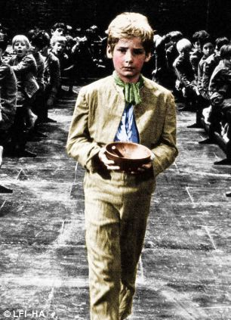
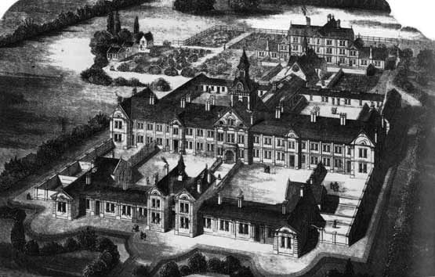
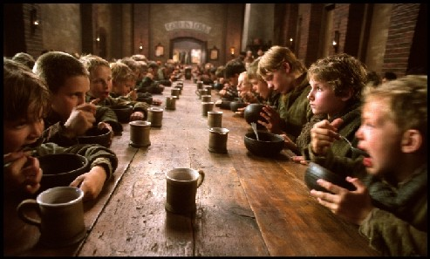
Children of almshouses as cheap labour for textile mills

Slide 3
Routine of a Child in Factories
Got up at 4-5 in the morning to pick up cotton waste from factory floors
Slappers were employed to slap an oozing child
Children of 6-7 put to spinning wheel or the loom
At 7.00am a frugal breakfast
One hour for lunch and toilet at 02.00pm
Working hours were completed at 5-6 in the evening, often hours later
Often 16-18 hours work

Slide 4
Result
Lack of sleep, of fresh air and sunshine, of rest and of any vacation
Undernourished, weak, and sick.
Many died in their teens because of working themselves to death

Slide 5
1802→ Health and Moral Act, Sir. Robert Peel
Working hours of pauper children reduced to 12 hours a day
restricted night work
But factory owners employed children directly from parents
1833→ Factory Act of 1833
Prohibited the employment of children under 9
Appointed factory inspectors
1847→ Factory Act of 1847
Limited the working hours of women and children (9-18 yrs) to 10 hours a day

